Slide 1
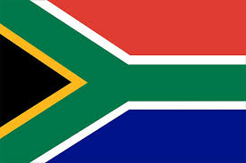

SOUTH AFRICA
By: Kendra, and Zankia

Slide 2
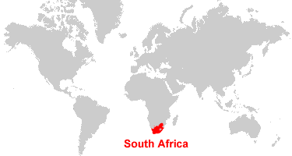
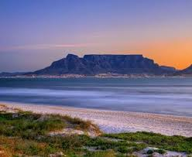
Country background
Language
South Africa is one of the countries known for language diversity, they have 12 official languages. They are divided into 3 main groups Bantu language, Germanic language, and sign language.
Ethnicity
black 75.2%, white 13.6%, Racialized person 8.6%, Indian 2.6%
Religions: Christian 68% (includes most whites and Coloreds, about 60% of blacks and about 40% of Indians), Muslim 2%, Hindu 1.5% (60% of Indians), indigenous beliefs and animist 28.5%
South Africa is known as one of the most beautiful countries in the world
Notes:
zankia

Slide 3
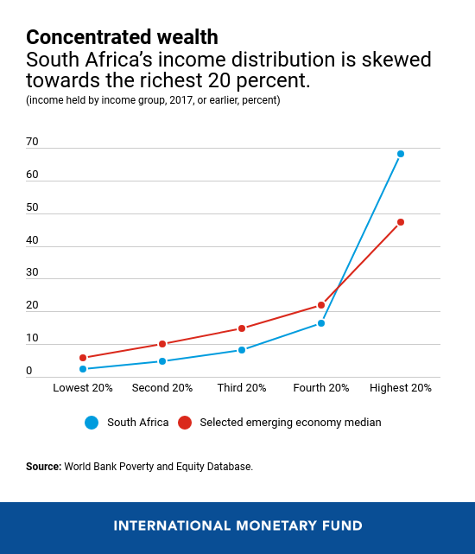
Global Issue
Income Inequality & Poverty
The top 20 percent of the population in south africa holds over 68 percent of income (compared to a median of 47 percent in other countries). The bottom 40 percent of the population holds 7 percent of income (compared to 16 percent in other countries). Similar trends can be observed across other measures, such as the income share of the top 1 percent. South Africa's unemployment rate is much larger than in other emerging markets. Youth unemployment rates going over 50 percent. This creates more low-skilled jobs to improve labor force participation. The unemployment rates exceed 30%, and systemic barriers persist. This leaves about 60% of the population living below the upper-middle-income poverty line.
Notes:
Kendra

Slide 4
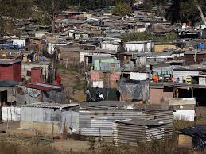
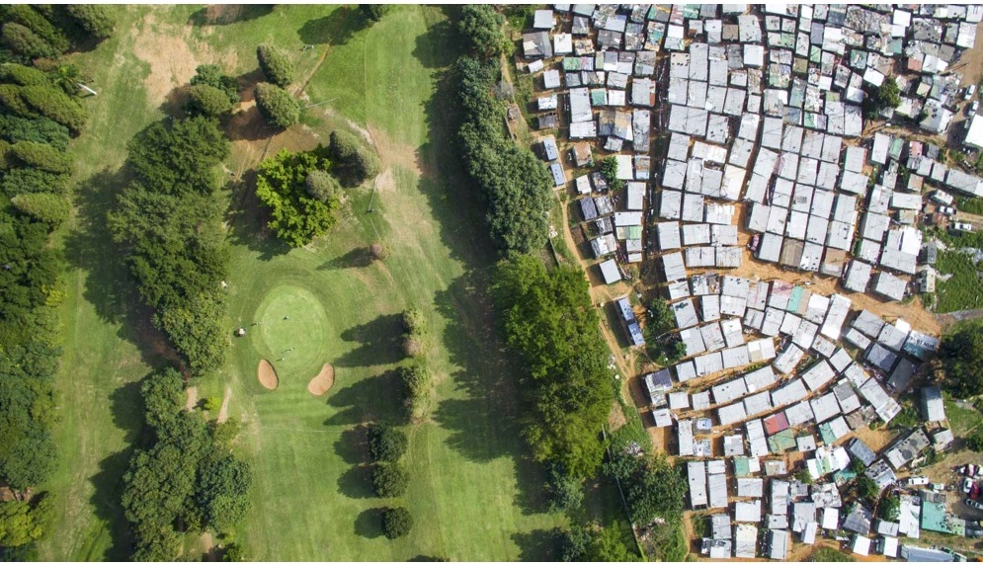
Country’s response
The South African government has used different techniques to deal with the stubborn levels of inequality that have worried the country. Including through progressive fiscal redistribution.In advanced economies, fiscal policy offsets about a third of income inequality before taxes and transfers, commonly known as market income inequality,with 75% coming from transfers. Spending on education and health also affects market income inequality over time by promoting social mobility, including across generations. In developing economies, fiscal redistribution is much weaker, given lower and less progressive taxes and spending.South Africa is focusing on more job opportunities and working on making jobs more available for all people.
Notes:
zankia

Slide 5
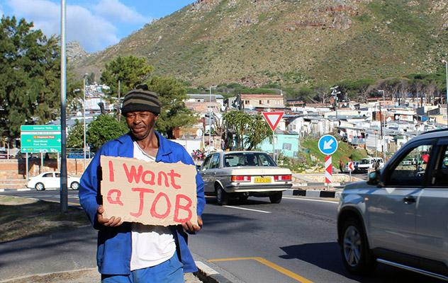
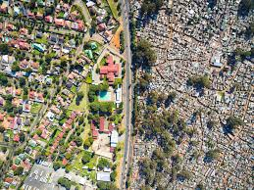
Consequences
In south Africa poverty surged from 55.5% to 62.7% (2020–2023). This is stopping millions access to jobs, water, healthcare, education, and food. This keeps them in a cycle of reliance on cheap, polluting energy. Many low-income workers endure long, expensive commutes from remote townships to city centers. This is only further draining their limited household budgets. Chronic unemployment, deep set racial divisions, severe strain social flow, and unequal access to opportunities. This economic divide keeps millions trapped in underfunded, impoverished(poor) townships, limited access to quality healthcare and education, and triggers widespread political instability.
Notes:
kendra

Slide 6
Canadian Comparison
South Africa: Characterized by a severe structural divide, South Africa holds the highest gini coefficient globally (often exceeding 0.63). Wealth and income remain intensely polarized along racial lines, with a small, wealthy elite contrasting sharply with mass unemployment.
Canada: Canada enjoys a significantly lower Gini coefficient (around 0.31 for disposable income), backed by a robust middle class and comprehensive progressive tax brackets that actively redistribute wealth. However, Canada faces growing wealth gaps at the very top, with significant billionaire accumulation alongside working-class struggles
South Africa: Poverty is highly absolute, multidimensional, and widespread. It impacts a massive portion of the population with immense deficits in basic infrastructure like sanitation and electricity. Mass unemployment (regularly hovering near 30%) leaves millions without any income, severely limiting upward mobility for the Black majority.
Canada: Poverty in Canada is usually relative, measured by the Market Basket Measure. Around 11% of Canadians live below the poverty line, but their hardships generally revolve around the skyrocketing cost of living (particularly housing) and challenges accessing adequate social and disability benefits.
Notes:
zankia,kendra

Slide 7


Thank you!!!!

Slide 8
Sources!!
Freeman Munisi Mateko et al. (2026). Asymmetric effects of poverty and inequality on carbon emissions in South Africa. Retrieved from: https://www.tandfonline.com/doi/full/10.1080/13504509.2026.2635053#d1e301
Gini Coefficient by Country. (2026). Gini Coefficient by Country. Retrieved from: https://worldpopulationreview.com/country-rankings/gini-coefficient-by-country
International Monetary Fund. (2020). Six Charts Explain South Africa's Inequality. Retrieved from: https://www.imf.org/en/news/articles/2020/01/29/na012820six-charts-on-south-africas-persistent-and-multi-faceted-inequality
Jeremy Seekings. (2019). Poverty and Inequality: South Africa as a Warning to Africa. Retrieved from: https://globaldialogue.isa-sociology.org/articles/poverty-and-inequality-south-africa-as-a-warning-to-africa
Statistics Canada. (2020). Statistics Canada confirms 4.5 million Canadians are living in poverty. Retrieved from: https://ca.finance.yahoo.com/news/statistics-canada-confirms-4-5-143000949.html
World Bank. (2018). World Bank study on South Africa exposes ANC’s failure to reduce poverty. Retrieved from: https://www.theglobeandmail.com/world/article-world-bank-study-on-south-africa-exposes-ancs-failure-to-reduce/
Notes:
Kendra,zankia

